Slide 1
Unit - 1

Slide 2
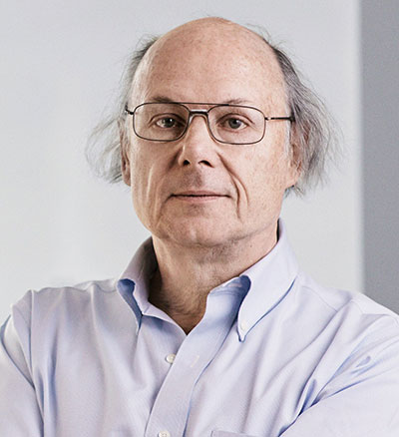
What is C++?
C++ is an object-oriented language.
Developed by Bjarne Stroustrup at AT & T Bell Labs in early 1980s.
C++ is an extension of C with support for
Classes,
Inheritance,
Function overloading, and
Operator overloading.
ANSI standardized C++ in 1997.
Supports bottom-up, object-oriented design.

Slide 3
Applications of C++
Using C++ you can develop editors, compilers, databases, communication systems and any complex real-life applications.
Build object-oriented libraries.
Develop machine-level programs.
C++ programs are easily maintainable and expandable.

Slide 4
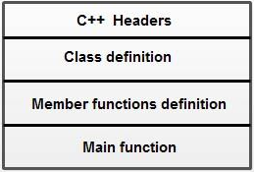
Structure of a C++ program

Slide 5
// Our first C++ program
#include <iostream>
using namespace std;
int main()
{
cout << "Hello world!" << endl;
return 0;
}

Slide 6
A program includes various programming elements like built-in functions, classes, keywords, constants, operators, etc., that are already defined in the standard C++ library. In order to use such pre-defined elements in a program, an appropriate header must be included in the program.
Standard input/output facilities are available in a header file named iostream.
A namespace permits grouping of various entities like classes, objects, functions and various C++ tokens, etc., under a single name.
The entities of the standard library are available under a namespace called std.
main() function is the entry point of execution of all C++ programs.
By default, main () in C++ returns an int value to the operating system. Therefore, main () should end with the return 0 statement.

Slide 7
Basic Data types
Built-in types
int, char, float, double and void
User-defined types
structure, union, class and enum
Derived types
array, function, pointer and reference

Slide 8
Variables
All variables must be declared before they are used in a program.
<data_type> list_of_variables;
However, C++ allows us to both declare and initialize variables wherever they are needed.

Slide 9
Reference variables
A reference variable provides an alias (alternative name) for a previously defined variable.
A reference variable must be initialized at the time of declaration.
<data_type> & reference_name;
Example:
float a = 10;
float & x = a;
Both variables refer to the same data object in memory.

Slide 10
Operators in C++
All C operators are valid in C++ also. In addition, C++ introduces some new operators:
:: Scope resolution operator
::* Pointer to member declarator
->* Pointer to member operator
.* Pointer to member operator
delete Memory release operator
endl Line feed operator
new Memory allocation operator
setw Field width operator

Slide 11
Scope resolution operator (::)
The scope resolution operator is used to access the value contained in a global variable that is hidden by declaration of a variable of the same name in local scope.
Note that :: will always refer to the global variable.
A major application of scope resolution operator is in the classes to identify the class to which a member function belongs.

Slide 12
Memory management operators
The unary operators new and delete perform the task of allocating and deallocating memory.
<data_type> <pointer_variable> = new <data_type>
Example:
int *p = new int;
*p = 10;
int *p = new int[20];
Here p acts as an array of 20 integer values.
p[0] refers to the first value
p[1] refers to the second value and so on…

Slide 13
Expressions and their types
An expression is a combination of operators, constants and variables arranged as per the rules of the language.
It may also include function calls which return values.
An expression may consist of one or more operands, and zero or more operators to produce a value.
Expressions can be of the following types:
Constant expressions,
Integral expressions,
Float expressions,
Pointer expressions,
Relational expressions,
Logical expressions and
Bitwise expressions.

Slide 14
Constant expressions consist of only constant values
14
20 + 5 / 2.0
‘x’
Integral expressions are those that produce integer results after implementing all the automatic and explicit type conversions.
m
m * n – 5
m + ‘x’
5 + int(3.6)
Float expressions are those which, after all conversions, produce floating-point results.
x + y
x * y / 10
5 + float(10)

Slide 15
Pointer expressions produce address values
&m
ptr
ptr + 1
“xyz”
Relational expressions yield results of type bool which takes a value true of false.
x <= y
a+b == c+d
m+n > 100
When arithmetic expression are used on either side of a relational operator, they will be evaluated first and then the results are compared.
Also known as Boolean expressions.

Slide 16
Logical expressions combine two or more relational expressions and produce bool type results
a>b && x==10
m==5 || n==10
Bitwise expressions are used to manipulate data at bit level.
x << 3
y >> 1

Slide 17
Operator overloading
Overloading means assigning different meanings to an operation, depending on the context.
C++ allows overloading of operators.
C also has overloaded operator in the form of *
<< and >> are overloaded operators in C++
cout << 75.56; // Displays a double value
cout << “Hello World”; // Displays a char value
Similarly, we can define additional meanings to other C++ operators. (We will discuss them later)

Slide 18
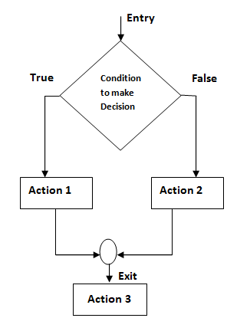
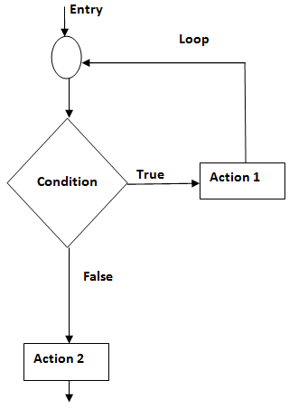
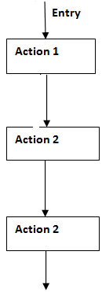
Control structures
Sequence
Selection
Iteration

Slide 19
Syntax of decision making and branching statements
if(condition1)
{
// code to be executed if condition1 is true
}
else if(condition2)
{
// code to be executed if condition2 is true
}
else if(condition3)
{
// code to be executed if condition3 is true
}
...
else
{
// code to be executed if all the conditions are false
}
switch (expression)
{
case value1: // statement sequence
break;
case value2: // statement sequence
break;
...
case valueN: // statement sequence
break;
default: // default statement sequence
}
if (condition1)
{
// code to be executed if condition1 is true
if (condition2)
{
// code to be executed
// if condition2 is true
}
}
if (expression)
{
true_statement_block;
}
else
{
false_statement_block;
}
if (expression)
{
statement_block;
}

Slide 20
Syntax of looping statements
while(condition is true)
{
statement 1;
statement 2;
...
statement n;
}
do
{
statement 1;
statement 2;
...
statement n;
}while (test_condition);
for (initialization ; test_condition; increment/decrement)
{
// statements to be executed
}

